Slide 1
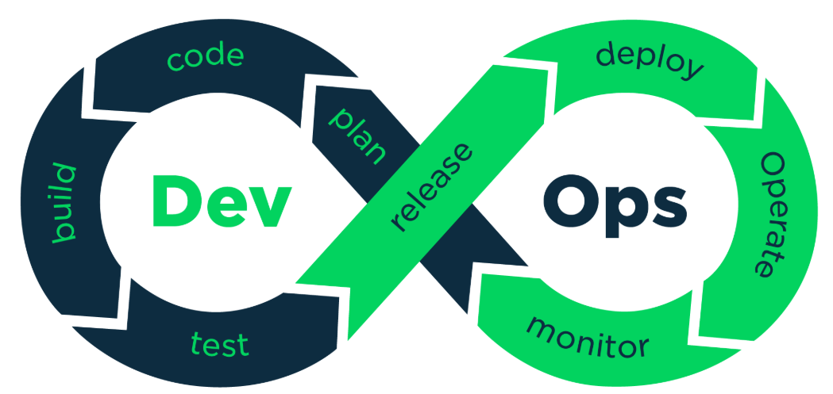

Slide 2
Devops
DevOps = Development + Operations
A cultural and technical movement to improve collaboration
Focuses on automation, continuous delivery, and rapid feedback
Enables faster, more reliable software delivery

Slide 3
Devops Principles – CALMS Model
Principle | Description
Culture | Collaboration, ownership, and shared responsibility
Automation | CI/CD, infrastructure as code, testing
Lean | Eliminate waste, optimize flow
Measurement | Metrics, KPIs, feedback loops
Sharing | Transparency, knowledge sharing, blameless postmortems

Slide 4
DevOps Lifecycle
Plan
Plan – Requirements, backlog grooming
Develop
Develop – Coding, peer reviews
Build
Build – Compile, package
Test
Test – Unit, integration, performance tests
Release
Release – Approval, versioning
Deploy
Deploy – Automated deployment
Operate
Operate – Monitoring, incident response
Monitor
Monitor – Feedback, analytics

Slide 5
Devops Tools
Stage | Tools Example
Plan | Jira, Trello
Develop | Git, GitHub, GitLab
Build | Maven, Gradle
Test | JUnit, Selenium, TestNG
Release | Nexus, Artifactory
Deploy | Jenkins, Spinnaker, ArgoCD
Operate | Docker, Kubernetes, Ansible
Monitor | Prometheus, Grafana, ELK Stack

Slide 6
Devops Practises
Practice | Description | Benefits | Common Tools
Continuous Integration (CI) | Developers merge code frequently into a shared repository. Automated builds and tests run on each commit. | Early bug detection, faster feedback, improved code quality | Jenkins, GitHub Actions, GitLab CI, CircleCI
Continuous Delivery (CD) | Code is automatically prepared for release to production after passing CI. | Faster, safer releases; reduced manual effort | Spinnaker, ArgoCD, GitHub Actions, Octopus
Infrastructure as Code (IaC) | Infrastructure is provisioned and managed using code and automation. | Consistency, scalability, version control of infrastructure | Terraform, Ansible, AWS CloudFormation
Automated Testing | Tests are executed automatically during CI/CD pipelines. | Faster validation, reduced human error, higher reliability | JUnit, Selenium, TestNG, Postman
Configuration Management | Maintains system configurations across environments. | Consistent environments, easier rollback, reduced drift | Chef, Puppet, Ansible
Monitoring & Logging | Tracks system performance and logs events for analysis. | Faster incident detection, better root cause analysis | Prometheus, Grafana, ELK Stack, Datadog
Version Control | Manages changes to source code and infrastructure. | Collaboration, traceability, rollback capabilities | Git, GitHub, Bitbucket, GitLab
Security Integration (DevSecOps) | Embeds security checks into CI/CD pipelines. | Early vulnerability detection, compliance enforcement | SonarQube, Snyk, OWASP ZAP
Containerization | Packages applications and dependencies into portable containers. | Portability, scalability, isolation | Docker, Podman
Orchestration | Manages container deployment, scaling, and networking. | High availability, automated recovery, efficient resource use | Kubernetes, OpenShift

Slide 7
What Is CI/CD?
CI (Continuous Integration): Developers frequently merge code into a shared repository with automated builds and tests
CD (Continuous Delivery/Deployment): Code is automatically prepared and released to production or staging environments
CI/CD is a cornerstone of modern DevOps practices

Slide 8
Components of CI/CD
Component | Description
Source Control | Versioning and collaboration (e.g., Git)
Build Automation | Compiling and packaging code
Automated Testing | Unit, integration, and regression tests
Artifact Repository | Stores build outputs (e.g., JARs)
Deployment | Pushes code to environments
Monitoring | Tracks performance and errors

Slide 9
Jenkins
Jenkins is an open-source automation server
Supports Continuous Integration (CI) and Continuous Delivery (CD)
Originally developed as Hudson at Sun Microsystems
Renamed to Jenkins in 2011 after a community fork

Slide 10
Key Components of Jenkins
Feature | Description
Freestyle Projects | Simple jobs with basic build steps
Pipelines | Scripted and declarative workflows
Plugins | 1800+ plugins for integration and customization
Distributed Builds | Supports master-agent architecture
Extensibility | Easily integrates with tools like Git, Maven, Docker

Slide 11
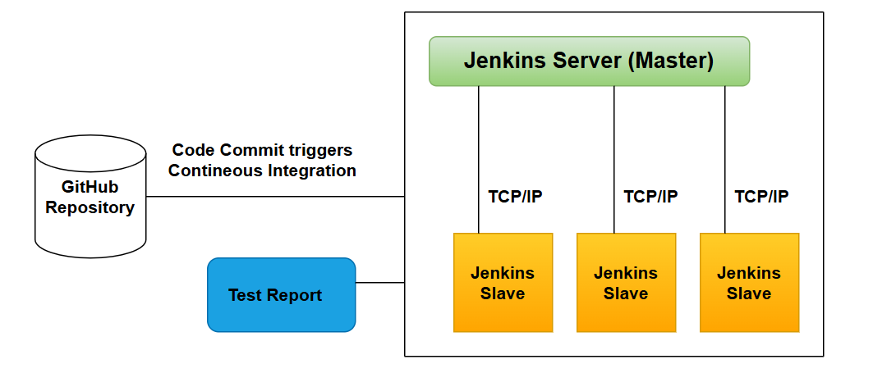
Jenkins Architecture
Master Node: Controls job scheduling and execution
Agent Nodes: Execute jobs on different environments
Web Interface: Configure jobs, view logs, manage plugins
Plugins: Extend Jenkins functionality (e.g., Git, Slack, Docker)

Slide 12

Jenkins Workflow
Developer pushes code to Git
Jenkins detects change via webhook
Jenkins pulls code and triggers build
Runs tests and generates reports
Packages and deploys if successful
Sends notifications (email, Slack)

Slide 13
Jenkins Jobs – Freestyle Project
The most basic and flexible job type
Configured via Jenkins UI
Supports shell scripts, build tools, and post-build actions
How to Create a job:
Create a new Freestyle job
Add Git repository
Add build step: Execute Shell → javac *.java
Add post-build step: Send email notification

Slide 14
Jenkins Jobs – Maven Project
Designed for Java projects using Apache Maven
Automatically detects pom.xml and runs Maven goals
How to Create Maven Project job:
Create a Maven job
Link to Git repo with pom.xml
Set goals: clean install
Jenkins runs Maven lifecycle automatically

Slide 15
Jenkins Jobs – Pipeline Project
Defines CI/CD workflow as code using Groovy
Supports complex logic, stages, and parallel execution
Can be scripted or declarative
How to create a Pipeline job:
Create a Multibranch Pipeline job
Connect to Git repo
Jenkins scans branches and runs Jenkinsfile in each

Slide 16
Summary
Job Type | Best For | Example Task
Freestyle | Simple builds and scripts | Compile and deploy Java app
Maven | Java projects with Maven | Run clean install on pom.xml
Pipeline | Complex CI/CD workflows | Build → Test → Deploy
Multibranch Pipeline | Branch-specific pipelines | Run tests on feature/login branch
Multi-Configuration | Matrix testing | Test app on multiple OS/browser combos
Parameterized | Dynamic builds | Deploy to selected environment
Folder | Job organization | Group jobs by team/project

Slide 17
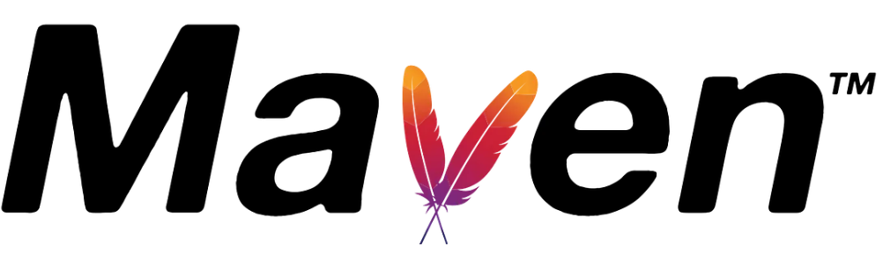

Slide 18
What Is Maven?
Maven is a project management and comprehension tool
Based on the Project Object Model (POM)
Automates build, documentation, reporting, and dependency management
Originally created for the Jakarta Turbine project

Slide 19
Key Features of Maven
Dependency management
Build lifecycle automation
Standard directory structure
Project documentation and reporting
Central and local repositories
Plugin-based extensibility

Slide 20
Maven Architecture
Component | Description
POM.xml | Core configuration file for the project
Repository | Stores dependencies (local, central, remote)
Plugins | Extend Maven functionality (e.g., compiler, surefire)
Lifecycle Phases | Clean, validate, compile, test, package, verify, install, deploy

Slide 21
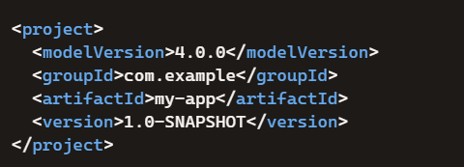
POM.XML
Defines project metadata and dependencies
Central to Maven’s build process

Slide 22
Maven Lifecycle Phases
Phase | Description
validate | Checks if the project is correctly configured and all required info is present
compile | Compiles the source code of the project
test-compile | Compiles the test source code
test | Runs unit tests using a testing framework (e.g., JUnit)
package | Bundles compiled code into a distributable format (e.g., JAR, WAR)
verify | Runs checks to ensure package meets quality standards (e.g., integration tests)
install | Installs the package into the local repository for use in other projects
deploy | Copies the final package to a remote repository for sharing

Slide 23
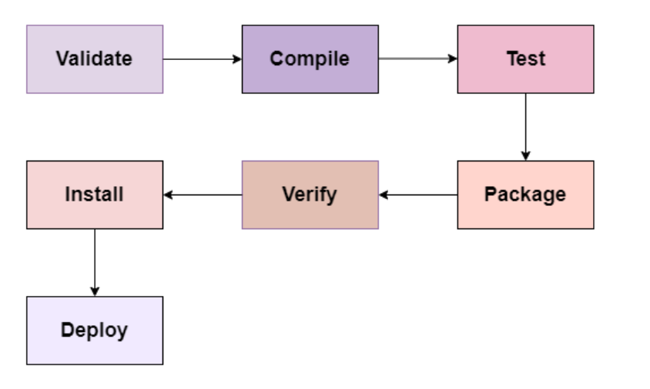

Slide 24
Maven Commands
Command | Purpose
mvn clean | Remove previous build artifacts
mvn compile | Compile source code
mvn test | Run tests
mvn package | Create JAR/WAR file
mvn install | Install to local repo
mvn deploy | Deploy to remote repo
mvn dependency:tree | View dependency hierarchy

Slide 25
Maven Repositories
Local Repository: Stored on developer’s machine
Central Repository: Default public repo (Maven Central)
Remote Repository: Hosted by organizations or third parties

Slide 26
Maven Plugins
Plugin Name | Purpose
maven-compiler-plugin | Compiles Java source code
maven-surefire-plugin | Runs unit tests with JUnit/TestNG
maven-failsafe-plugin | Executes integration tests
maven-jar-plugin | Packages code into a JAR file
maven-war-plugin | Creates a WAR file for web applications
maven-assembly-plugin | Builds custom distributions (ZIP, TAR, etc.)
spring-boot-maven-plugin | Packages Spring Boot apps into executable JARs

Slide 27
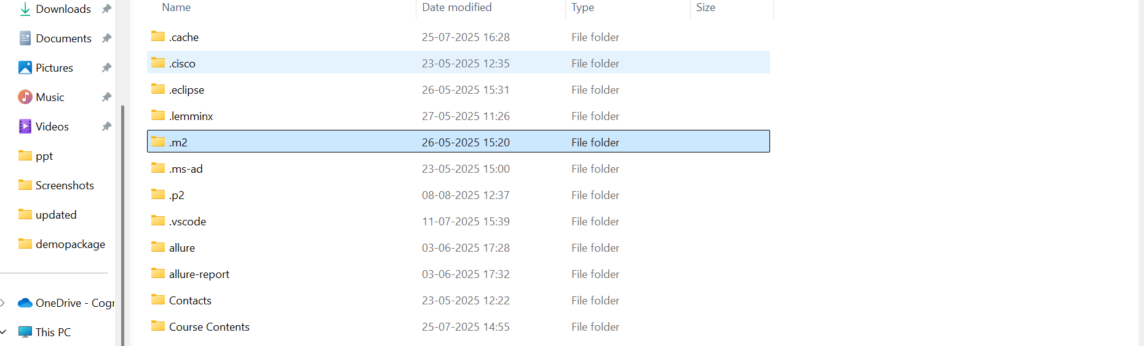
.m2 Folder
The default location of the Maven local repository is within the .m2 directory
Inside this .m2 folder, there is a repository subfolder where Maven stores downloaded dependencies and plugins
C:\Users\{your-username}\.m2\repository

Slide 28
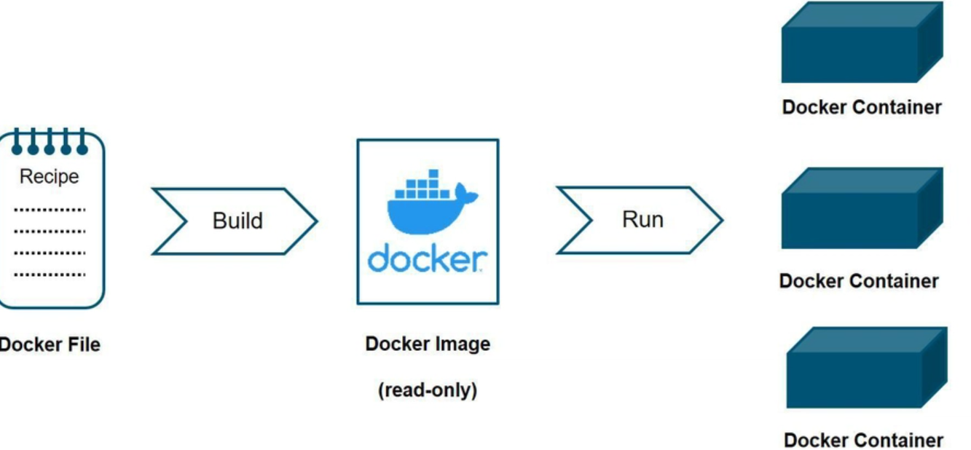
Containerization

Slide 29
What Is Containerization
A method of packaging software with its dependencies
Ensures consistency across environments
Lightweight, portable, and isolated execution units
Analogy: Like shipping containers for software

Slide 30
Docker
An open-source platform for containerization
Automates deployment of applications in containers
Solves the “it works on my machine” problem
Over 14 million active developers use Docker globally

Slide 31
Components of Docker
Component | Description
Docker Engine | Core client-server architecture
Docker Images | Read-only templates for containers
Docker Containers | Running instances of images
Dockerfile | Script to build images
Docker Hub | Public registry for sharing images

Slide 32
How Docker Works

Slide 33
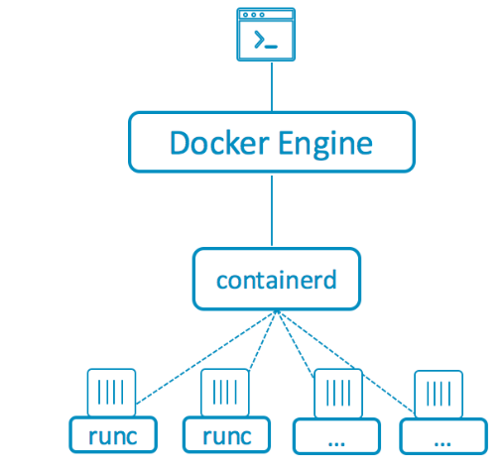
1. Docker Engine
The core of Docker: a client-server application.
Client: You run commands like docker build, docker run.
Daemon: Executes those commands and manages containers.

Slide 34
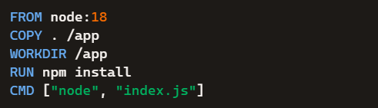
2. Docker file
A text file with instructions to build a Docker image.
FROM: Base image
COPY: Adds files
WORKDIR: Sets working directory
CMD: Default command to run

Slide 35
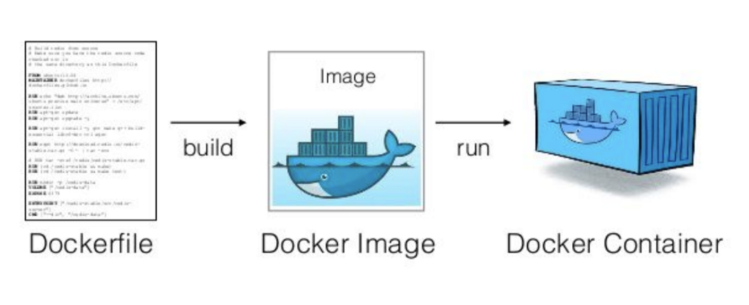
3. Docker Image
A snapshot of your application and its environment.
Built from a Dockerfile.
Stored locally or on Docker Hub.

Slide 36
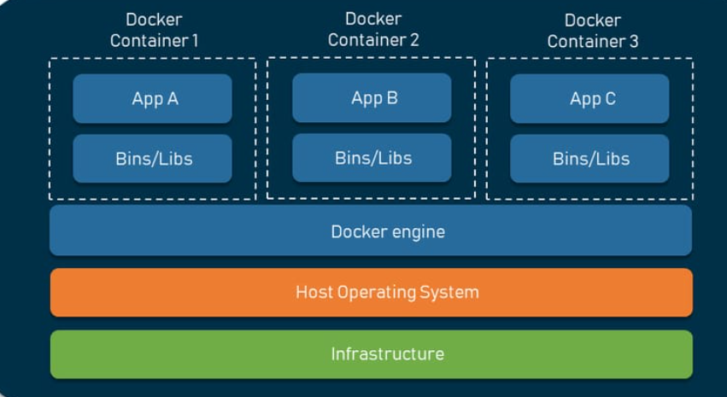
4. Docker Container
A running instance of an image.
Isolated from the host system.
You can start, stop, and delete containers easily.

Slide 37
5. Docker Hub
A public registry for sharing Docker images.
You can pull ready-made images like nginx, mysql, or python.

Slide 38
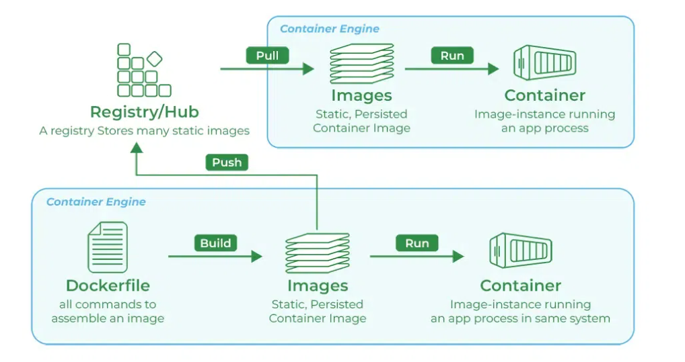
Summary

